Slide 1
On permutation boxed mesh patterns
Sergey Kitaev
University of Strathclyde

Slide 2
Permutations
Permutations are considered in one-line notation, e.g. 526413
The corresponding permutation diagram is

Slide 3
Classical patterns
The pattern 132 occurs in the permutation 526413 three times
The occurrences of 132 = are

Slide 4
Classical patterns
The same permutation
avoids the pattern
123 =

Slide 5
Vincular (generalized) patterns
Requirement for some elements to be adjacent
The pattern occurs in 526413
occurrence
non-occurrence
non-occurrence

Slide 6
Consecutive patterns
A subclass of vincular patterns
The pattern occurs in 526413
occurrence
non-occurrence
non-occurrence

Slide 7
Bivincular patterns
Additional requirements for some values to be adjacent
The pattern does not occur in 526413
non-occurrence
non-occurrence
non-occurrence

Slide 8
Mesh patterns
Any square in a pattern can be shaded
The pattern occurs in 526413
non-occurrence
non-occurrence
occurrence

Slide 9
Boxed mesh patterns
A square in a pattern is shaded iff it is internal
The pattern occurs in 526413
occurrence
non-occurrence
occurrence

Slide 10
Patterns hierarchy
mesh patterns (Branden, Claesson; 2010)
boxed mesh patterns
(Avgustinovich, Kitaev, Valyuzhenich; 2011)
bivincular patterns
(Bousquet-Melou, Claesson, Dukes, Kitaev; 2009)
vincular patterns (Babson-Steingrimsson, 2000)
consecutive patterns
classical patterns (Knuth, 1968)

Slide 11
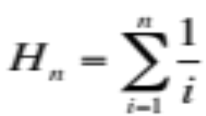
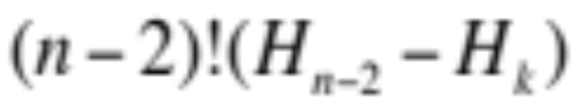
Nice facts on mesh patterns by Kitaev and Liese (work in progress)
The distribution of the border mesh pattern
on permutations of length n can be expressed in terms of the Harmonic numbers
as , where
k is the number of occurrences of the pattern.

Slide 12
Nice facts on mesh patterns by Kitaev and Liese (work in progress)
The distributions of the mesh patterns
and
on 132-avoiding permutations is given by the Catalan triangle, while the distribution of
on these permutations is given by the reverse Catalan triangle.

Slide 13
Boxed mesh patterns
132
Notation: =
A simple (but useful!) observation: a permutation contains p if it is possible to obtain p by removing from the permutation’s diagram a few (maybe none) leftmost, rightmost, topmost and bottommost elements

Slide 14
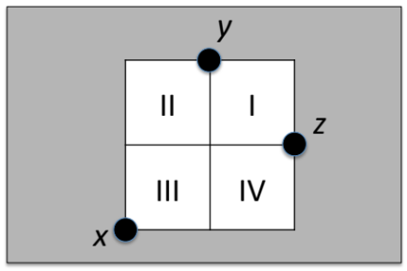
Avoidance of boxed mesh patterns
Notation: Av(p) = the set of permutations avoiding p
Av(1) = Av( 1 ) (trivial)
Av(12) = Av( 12 ) and Av(21) = Av( 21 ) (an occurrence of, say, 21 in a permutation leads to an occurrence of a descent, which is an occurrence of the pattern 21 ; the reverse is trivial)
Av(132) = Av( 132 ) (if xyz is an occurrence of 132, then either it is an occurrence of 132 or there is another occurrence of 132 with
elements being “closer” to each
other; the rest of the proof is easy)

Slide 15
Avoidance of boxed mesh patterns
Av(123) ≠ Av( 123 ), e.g. the permutation
avoids the pattern 123 but does not avoid 123.
This is the only permutation of length 4 with the
property.

Slide 16

Avoidance of boxed mesh patterns
Notation: s_{n}(p) = # of n-permutations avoiding p
Trivial bijections: reverse 2431 ➔ 1342; complement 2431 ➔3124; inverse 2431 ➔ 4132; compositions based on the three operations
If f is a trivial bijection and p₂=f(p₁) then
s_{n}( p₁ )=s_{n}( p₂ )
Proposition. Except for p {1,12,21,132,213,231,312},
s_{n}(p) ≠ s_{n}( p ).
Conjecture. For p and q of the same length at least 4,
s_{n}(q) ≠ s_{n}( p ).

Slide 17
Avoidance of monotone boxed patterns
Theorem (ErdŐs and Szekeres). Any sequence of ml+1 real numbers has either an increasing subsequence of length m+1 or a decreasing subsequence of length l+1.
In particular, increasing and decreasing patterns are unavoidable on permutations.
Clearly, if one of the monotone boxed mesh patterns is of length at most 2, these patterns are unavoidable.
What can we say about other monotone boxed mesh patterns? Are they avoidable or unavoidable?
Notes:
“Boxed patterns” = “boxed mesh patterns”.

Slide 18
Avoidance of monotone boxed patterns
It turns out that even in a stronger sense (when one of the monotone patterns is a boxed mesh one, whereas the other one is a classical one) the length 3 or more monotone boxed mesh patterns are avoidable:
Proposition. For n≥0, the sequence s_{n}( 123 , 321 ) is 1, 1, 2, 3, 6, 4, 4, 4, 4, …, and the sequence
s_{n}( 321 ,123)=s_{n}(321, 123 ) is 1, 1, 2, 4, 5, 2, 2, 2, … .

Slide 19

Former Stanley-Wilf conjecture
Conjecture (Stanley and Wilf). For any classical pattern p the limit exists and is finite.
The conjecture was proved by Marcus and Tardos in 2004.
Is the Stanley-Wilf conjecture true for boxed mesh patterns?

Slide 20

Asymptotic growth for permutations avoiding boxed mesh patterns
The Stanley-Wilf conjecture is not true for 123 :
Theorem. We have s_{n}( 123 ) > ( )!
Proof. Take any permutation and substitute each element by two decreasing elements to get a good permutation.

Slide 21

Asymptotic growth for permutations avoiding boxed mesh patterns
The Stanley-Wilf conjecture is not true for 123 :
Theorem. We have s_{n}( 123 ) > ( )!
Upper bound for s_{n}( 123 ) is
given by Eulerian numbers.
Henning Ulfarsson

Slide 22
Asymptotic growth for permutations avoiding boxed mesh patterns
Using similar approach, but more complicated analysis, one can prove the following theorem.
Theorem. We have s_{n}( p ) > ( )! for any p of length at least 4 not belonging to the set
{2143, 3142, 2413, 3412}.
Note that we in fact have only two unknown cases, not four, because of the trivial bijections.

Slide 23
Asymptotic growth for permutations avoiding boxed mesh patterns
Summary:
Pattern p | Stanley-Wilf conjecture for p
1, 12, 21, 132, 213, 231, 312 | True
2143, 3142, 2413, 3412 | Unknown
any other pattern | False

Slide 24
Mesh patterns with one shaded square
There are more than ( )! permutations avoiding the pattern
The problem is actually
on characterization of
barred patterns with
one bar.
Problem. Characterize one-shaded
square patterns for which the
Stanley-Wilf conjecture is not true.
shuffling with
decreasing
sequence

Slide 25
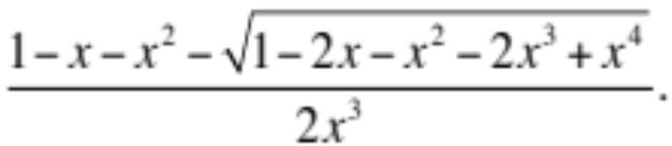
Multi-avoidance of length-three boxed mesh patterns
Theorem. s_{n}(132, 123 )=s_{n}(132, 123)=2^{n-1}.
Theorem. s_{n}(231, 123 ) is given by the generalized Catalan numbers. The respective generating function is

Slide 26
Thank you for your attention!
Any questions?

